Slide 1


Amravati
Vidarbha’s Gateway
Smart City Proposal
Annexure 3

Slide 2
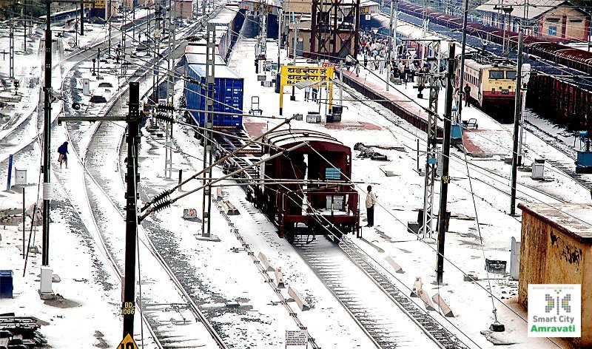
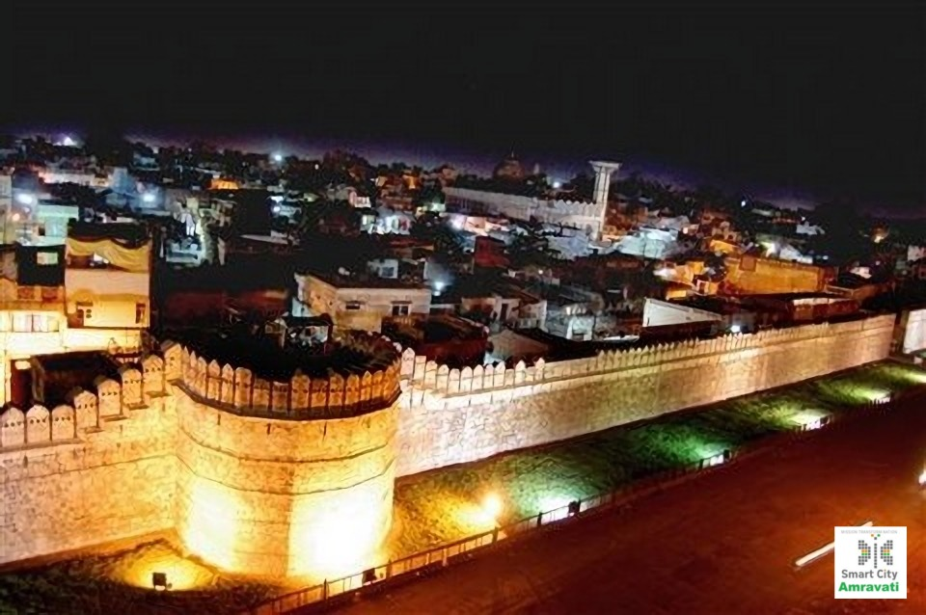
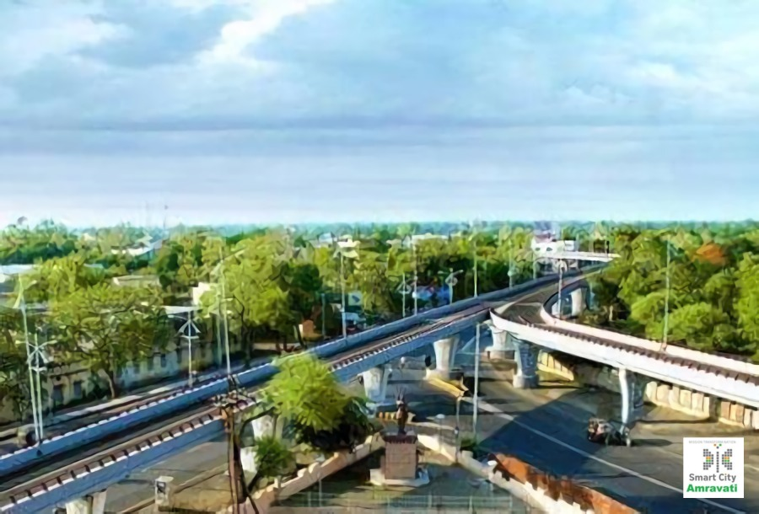
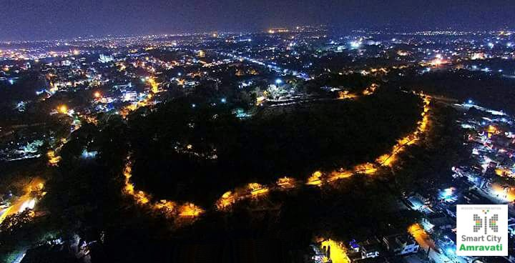
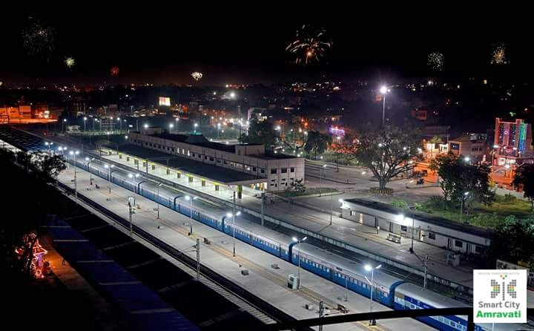
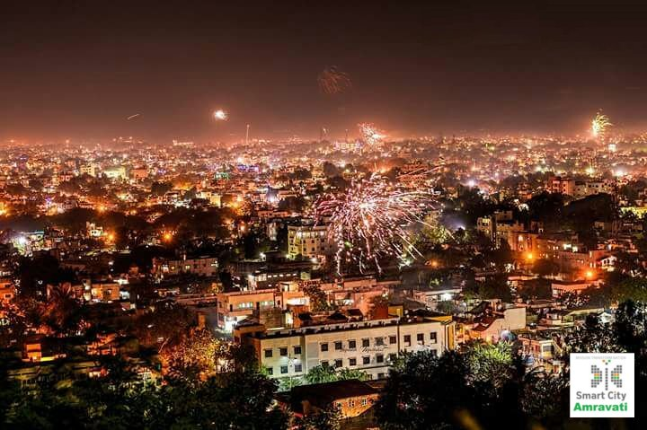
Index
Index
3.1
3.2
3.3
3.4
3.5
3.6
3.7
3.8
3.9
3.11
Implementation Plan Pan City
Financial Overview
Pan City Costing
City Profile
Citizen Engagement
Vision and Goals
ABD Overview
Pan City Overview
Stakeholder Roles
Implementation Plan ABD
3.10
ABD Costing

Slide 3
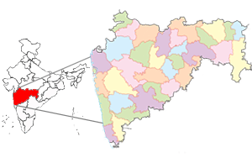
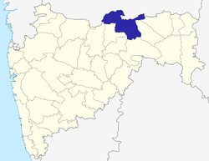
3.1
City Profile
Transportation
120 km new roads built, 40 new buses added
Smart signalling at the major junction
Water Supply
Self sustaining, linkage with Upper Wardha Dam, 950 km pipeline
WTP capacity 95 MLD, reduction in NRW
Solid Waste Management
D2D garbage collection 80% coverage, segregation at source
Toilets constructed in >96% identified households
Housing
Safety and Security
Energy
100% household coverage, storage 679mm3, 15 reservoirs
ODF status for all 43 wards in city
199 locations for CCTV cameras identified
Regional Disaster Management Center (RDMC) setup in 2014 covering all 40 municipal councils in 5 districts of Amravati division
100% conversion of streetlamps to LED - Street Light National Program
Sensor enabled Centralised Control Monitoring System (CCMS) installed
No load shedding, plan to install solar panels on all government buildings
~70% houses constructed under under Ramai Awaas Yojana
Digital property tax collection
Auto DCR project implementation completed in 2012
Exclusive bus services for women and students
M/F – 960/1000 | Literacy – 92%
Population in ‘000s

Slide 4
3.2
Citizen Engagement
Campaign aimed at reaching out to diverse groups of citizens including women, youth, senior citizens, slum-dwellers as well as the business community
Diverse citizen groups – age, gender, education, area
Marquee events – marathon, tech fair
Inclusion
MyGov
Discuss – Open forum discussion for citizens to give their views and suggestions
Poll – Poll to identify the best area for Area-based development
Talk – FGD session streamed live on MyGov and available on YouTube for subsequent reference
Smart City Amravati portal (ABD poll and survey for identifying issues)
Facebook/ Twitter interaction
Email
Focus-group discussions
  Indian Medical Association
  Chamber of Commerce
  Bar Association
  MIDC
  CREDAI
  Youth interactions (Ram Meghe & Sipna College Of Engineering)
Physical survey conducted (1 lakh forms)
Feedback via postal mail
Online
Understand important concerns
Building stakeholder consensus
Deliberation
Prioritising initiatives
Refinement of proposal
Refinement
Stakeholder mapping and citizen comments
Focussed discussions
Feedback
Major issues identified
Issue of garbage collection, solid and waste-water management (Addressed in ABD)
Lack of employment opportunities (Addressed in ABD)
Poor public transport availability and last-mile connectivity (Addressed in Pan-city)
Lack of parking facilities (Addressed in Pan-city)
Traffic due to narrow lanes and high penetration of private vehicles (Pan-city)
Offline

Slide 5
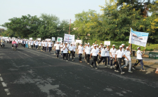
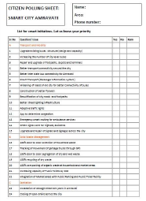

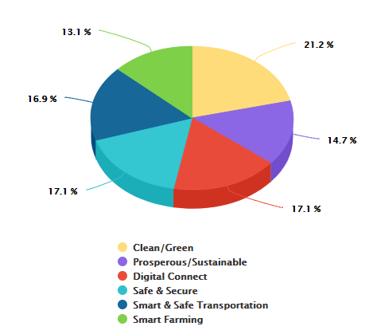

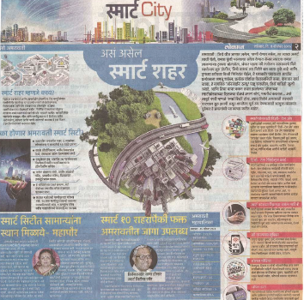


3.2
Citizen Engagement
Citizen Participation
4000+
Walkathon
Essays
Citizen Survey
7500+
146000+
Discussions
FGDs
Offline Survey
31000+
63000+
Walkathon
Online mediums
Citizen Priorities
Consultations
13000+
30000+
Tech Fair
Meetings & Visits
Dedicated Website - https://www.smartcityamravati.com
IEC through print

Slide 6
3.3
Vision and Goals
Vidarbha's Gateway Amravati desires to create DELIGHTFUL LIFE by providing quality infrastructure, urban services, education and leisure facilities and DIGNIFIED LIVELIHOOD by generating new economy jobs and sustaining agro-tech industries for one and all
City Vision
STRENGTHS
WEAKNESSESS
Economic Epicenter Of Vidarbha
Availability of Resources
Educational Hub
Rich In History And Heritage
Sports Capital of Vidarbha
Unplanned Growth leading to Poor Core Infrastructure
Incomplete Urban Mobility
Ineffective Waste Management
OPPORTUNITIES
Development Of Amravati As A Production Hub
High Number Of Graduates to setup new age Agro Tech Industries
Focus on Tradition and Culture of Amravati to Enhance its Tourism Potential
THREATS
Migration
Unpredictable Rains
Increase in Number of Private Vehicles
Leveraging the Location
Improving Economic Vitality Leading To Employment Generation
Enhancement Of Basic Utilities And Services By Responsive Governance
Improve Mobility Within The City
Wellbeing Of The Citizens
Leveraging The Rich History And Tradition Of The City To Open A New Avenue In Tourism
Strategic Focus Areas
S
W
O
T
Provide quality infrastructure | Boost agro-tech sector | Ensure high quality G2C and G2G services by enhancing delivery mechanism
DELIGHTFUL LIFE / DIGNIFIED LIVELIHOOD
Create facilities for leisure | Impetus on new economy jobs |  | Sustain educational and sporting opportunities available in the city
Goals

Slide 7
Area Based Components

Slide 8
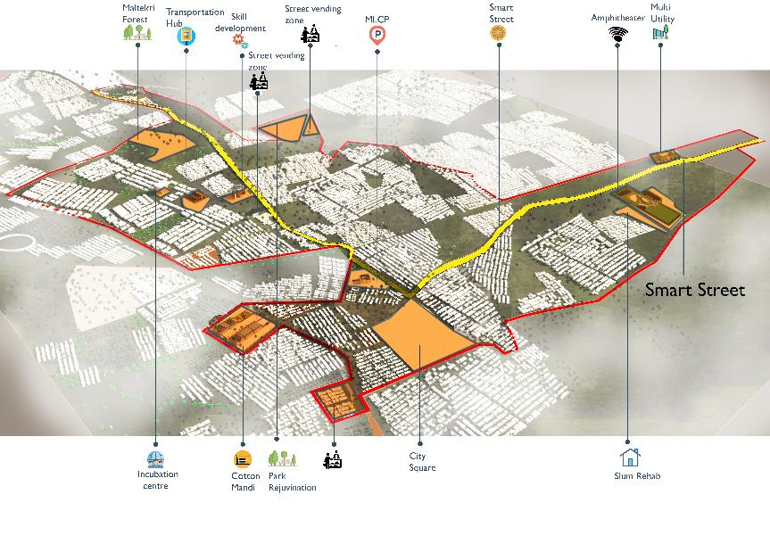
3.4
Overview – Area Based Development
Amravati’s proposal envisions to retrofit 958 acres in the Heart of the city, centered around AMBA (Amravati’s Maltekri- Bus Stand- Ambadevi Temple) area to create sustainable socio-economic development fabric.
57,622
52%
48%
9% of City Population
11,524
Households
60% Citizen Voted in Favor of AMBA ABD area
Land Use
8% -Commercial
53%-Residential
5%-Open Space
12% -Public
3%- Transport
19% Roads
Ward No.
7,8,12,13,18,19
3
5
1
Basic Infrastructure
Upgradation
Urban Space
Upgradation
Components
Economic Vitality and Employment
Mobility
Imprvement
Heritage
Restoration
2
4

Slide 9
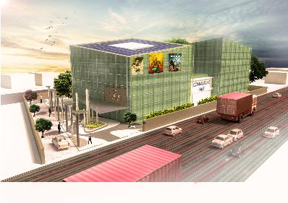
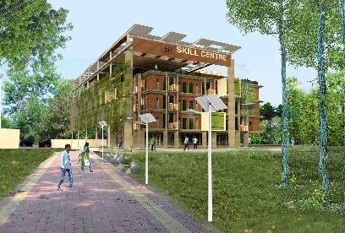
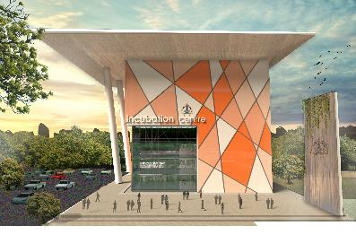
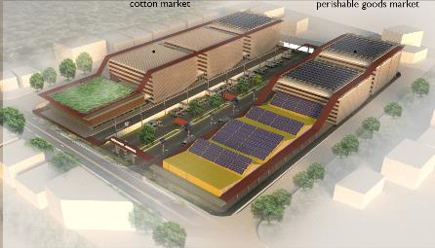
3.4.1
ABD Component 1 – Economic Vitality & Employment Generation
To catalyze the local and regional economy of the city, AMBA area has been proposed with four projects covering varied services and simultaneously generating employment opportunities for the deserving.
Skill Development Center (G+3 Floors) : Griha Platinum Rating Building for formal skill development. Generating Emp. 330 Nos
Multi Utility Building (G+6 floors ) : Mixed land Use space for Integrated Command and Control Center, Entertainment, Offices, Commercial and Retail
Skill
Development Cenre
Multi Utility Building
(Trade Centre)
Projects
0.6 acre land D.Ed College
1.63 acre land at Navathe Area
Agro Based Market Upgradation
Incubation & Innovation Centre
Agro Based Market Upgradation at Cotton Mandi (G+3 floor) : work as a catalyst for local economy. Providing commercial and storage spce for local products.
Incubation & Innovation Centre (G+ 7) Iconic Building : Developing Entrepreneurship and World Class Business platform for emerging startups
3250
Employment Generation
6.48 acre land at Cotton Mandi
0.47 acre land at Gov. Tech. Edu. College

Slide 10
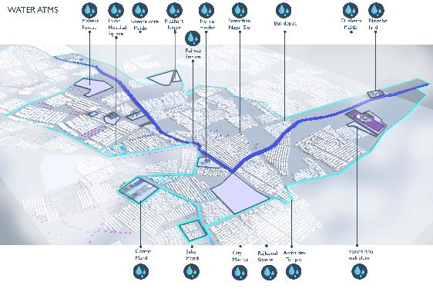
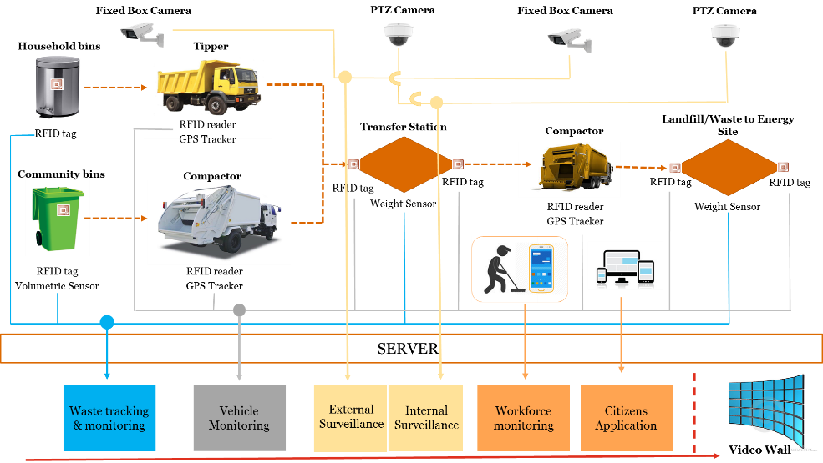
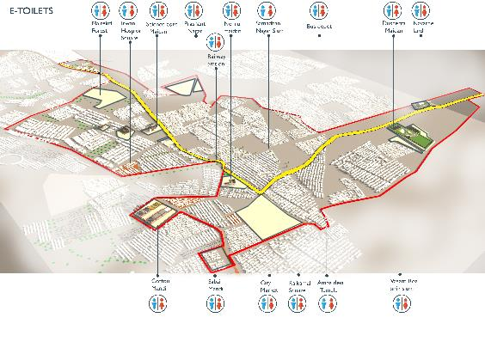
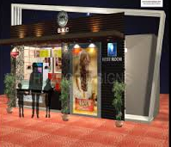
3.4.2
ABD Components 2 - Basic Infrastructure Upgradation
30 Nos Water ATMs
35 Nos E-Toilet
Solid Waste Management Integrated with Command and Control Center
300 Nos Smart dustbins , 50 Nos Underground Bins
Smart Water and Electric Meter for 11,526 Households and SCADA systems for the area.
Solar Roof Top
6.5 MW
Phase 1 – 18 Old Building
Phase 2 – 6 New Building
Slum Redevelopment
Vasant Rao Naik Slum
G+3 Structure PMAY Comp- 2
2.76 acre
330 Households
5 Nos
She- Lounge for Women Safety
Rain Water Harvesting
Phase 1 – 18 Old Buildings
Phase 2 – 6 New Building
Illustrative Image

Slide 11
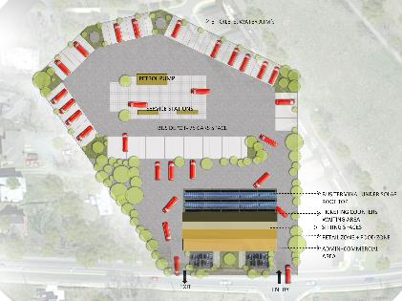
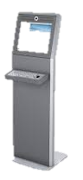
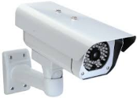

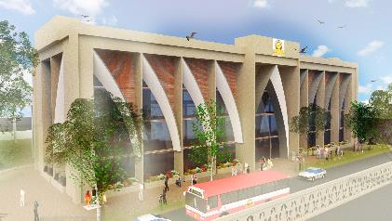
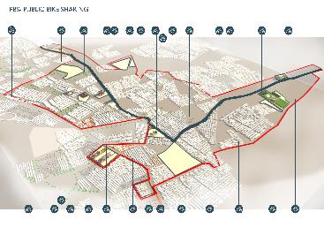
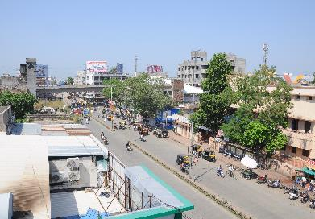
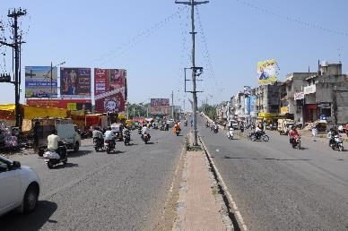
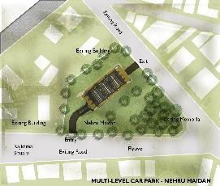
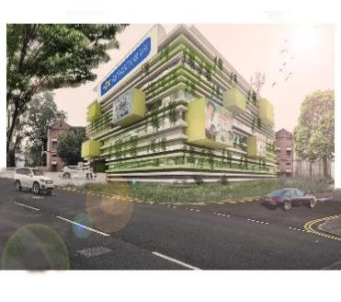

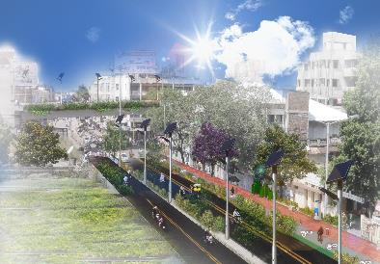
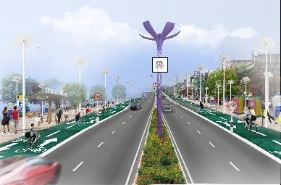
3.4.3
ABD Components 3 – Mobility Improvement
ITMS systems
150 CCTV cameras
In ABD area
No Vehicle Zones
Aa Shivaji Market
7.8 Km road/ 46 acre
20 Nos
Navigation Signage
Along Smart Road
17 Km NMT Infrastructure
30 Docking Stations
400 Nos Cycles
20 E- Buses
Rajapet Bus Depot
100 Nos E-Rickshaw
4 Charging Stations
MSRTC Bus Depot – Master Layout
& Commercial Building
Footpath Redesign, Junction Improvement, Alfresco Areas 4 NOS, facade rejuvenation – Smart Road 4.15 km
Transformation
Transformation
Proposed MLCP facility with Smart Parking at Nehru Maidan , 400 ECS
Proposed Concept of Smart Road

Slide 12
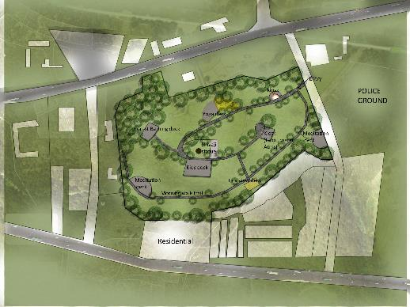
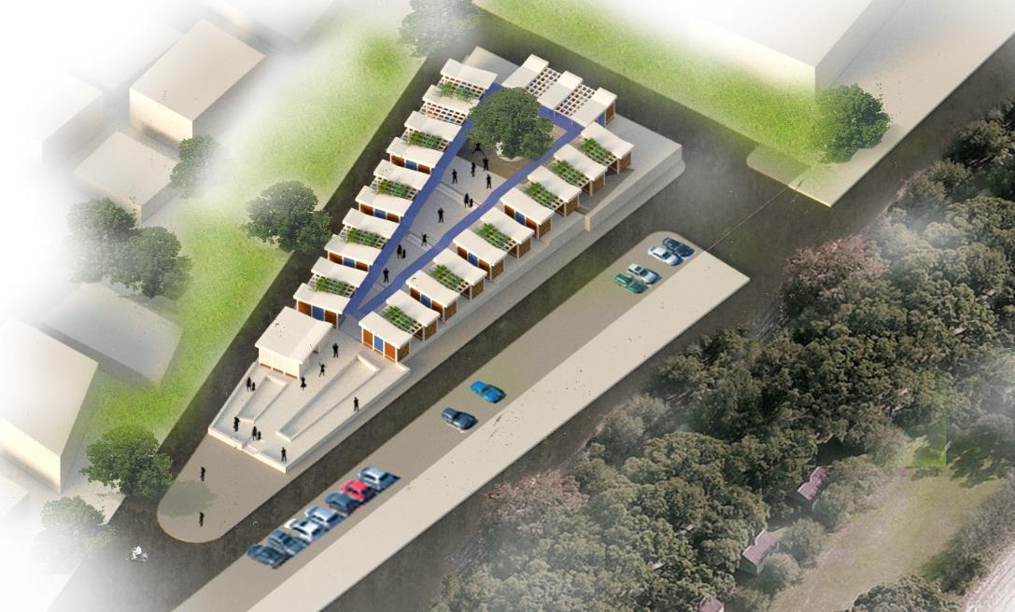
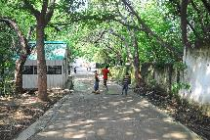
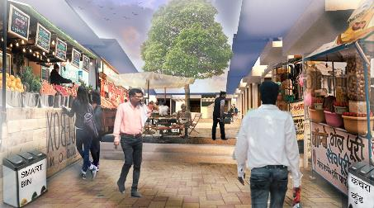
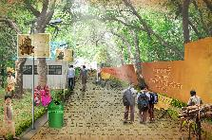
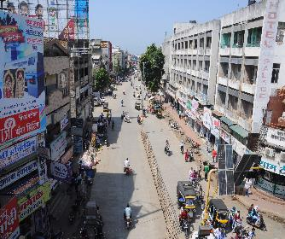
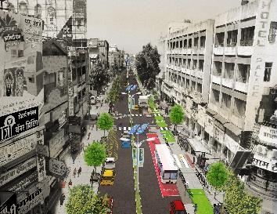
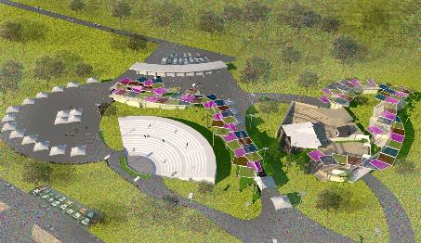
3.4.4
ABD Components 4 – Urban Place Making
21.6 Acres
Food Vendor Zone at
Prashant Nagar
50 Kiosk in 1.18 Acres
Science Core Maidan
80 Kiosk in 1.80 Acres
Master Layout for Maltekri Forest Garden
15 Nos Junction for Upgradation
6 Nos Location for Alfresco Design
Vertical Gardening at the New Buildings
Façade Improvement along the Smart Road
Food Vendor Zone Concept
Maltekri Transformation
City Square Proposed Transformation at Rajkamal Chawk
13.0 Acres
Amphitheater at Dusherra Maidan

Slide 13
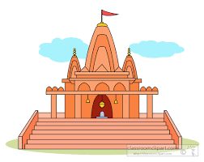
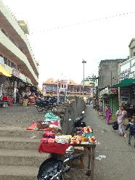
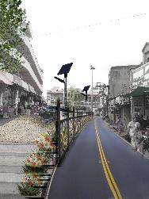
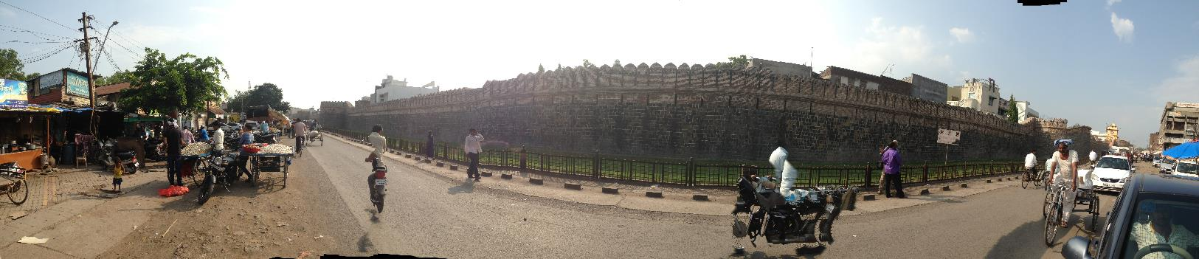

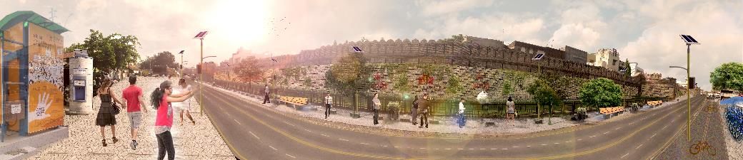
3.4.5
ABD Components 5 –Heritage Restoration
Ambadevi Temple Transformation
To restore the heritage of the city and conserve the essence of the culture, Heritage Restoration has been selected as one of the projects component
0.8 Km of Heritage Road Upgradation
4 Heritage Gates Upgradation
Netaji Subhas Chandra Bose Road
Ambadevi & Ekvira Temple
Heritage road and walled city – Present condition
Heritage road and walled city – Proposed Transformation

Slide 14
Pan City Components

Slide 15
3.5
Pan City Components
Addressing Concerns
Lack of parking space
Profiling and Self Assessment
Citizen Engagement
Elected Representatives opinion
Urban and Social Experts opinion
Discussion with suppliers, partners
Lack of availability & predictability
of public transport
High number of private vehicles
Smart Commute
Lack of last mile connectivity
Approach
Concerns
Lack of traffic discipline
Inefficient public service delivery
Smart Municipal Operations
Low safety and security
Digital disconnect
Connectivity for All

Slide 16

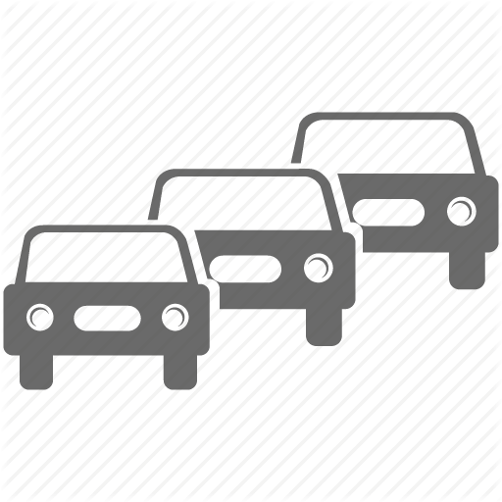

3.5.1
Pan City Components
Smart Commute
04
Integrated Command and Control Center
Smart Municipal Operations
05
Smart Parking
Integrated Transit Management System
PIS and Multi-modal transport integration
In bus surveillance, GPS, GIS
Intelligent pedestrian crossing
Intelligent Traffic Control System and Traffic Violation System
CCTV Surveillance, AUTO CHALLAN for traffic violators & E-CHALLAN for transparency
ANPR & RLVD system
Solar Wireless traffic controller- adaptive traffic signals, and Solar blinkers
Smart Parking
Smart Parking to reduce congestion
03
ERP, Mobile App and Business Portal
Integrated Command and Control Center
ICCC and Dashboard
Surveillance
Environment sensors/ Digital display
ERP, Mobile App
AMC ERP Integration
Online service delivery via portal and app
GIS Mapping
GIS layers mapping of City areas
06
Intelligent Traffic Control and Traffic Violation System
02
GIS mapping
Integrated Transit Management System
07
Smart Poles
Connectivity for All
Smart Poles incl. LED
City-wide Wi-Fi to improve connectivity
01
City Wi-Fi
Connectivity For All
08

Slide 17
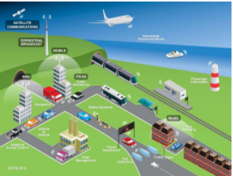
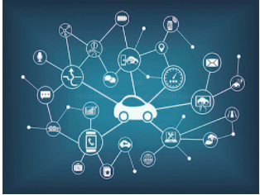

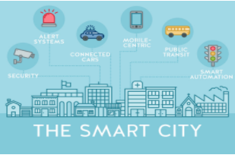

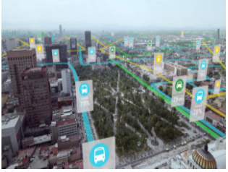
3.5.2
Pan City Components
1 | PIS and Multi-modal transport integration
2 | In bus surveillance, GPS, GIS
3 | Intelligent pedestrian crossing
4 | CCTV Surveillance, AUTO CHALLAN for traffic violators & E-CHALLAN for transparency
5 | ANPR & RLVD system
6 | Solar Wireless traffic controller- adaptive traffic signals, and Solar blinkers
7 | Smart Parking
8 | ICCC and Dashboard
9 | Surveillance
10 | Environment sensors/ Digital display
11 | AMC ERP Integration
12 | Online service delivery via portal and app
13 | GIS Mapping of City areas
14 | Smart Poles
15 | City-wide Wi-Fi
4
2
5
10
7
13
8
11
15
12
14
9
1
6
3

Slide 18
3.6
Stakeholder Roles
Head of Transport | Head of Water & Sewerage | Head of Operations & Services | Head of Technical Operations | CFO | CVO | Chief Urban Planner

Slide 19
3.7
Implementation Plan – Area Based Development

Slide 20
3.8
Implementation Plan – Pan City

Slide 21
3.9
Financial Plan - Overview
Total SCP Cost 1313.76 Cr
ABD Cost (Capex + Opex) 936.19 Cr
Pan City Cost (Capex + Opex) 377.57 Cr
Source of Funds
Smart City Funds Centre – 500 Cr
Smart City Funds State & ULB – 500 Cr
Centre Schemes Convergence Funds – 320.38 Cr
State Schemes Convergence Funds – 26 Cr
 | Project Component | Total Cost | Capex | Opex
Area Based Components
A1 | Economic Vitality | 301.91 | 257.57 | 44.34
A2 | Basic Utilities and services | 321.00 | 275.00 | 46.00
A3 | Walkability and Mobility | 167.10 | 138.10 | 29.00
A4 | Citizen well-being | 107.60 | 89.00 | 18.60
A5 | Restoration of culture | 38.58 | 34.00 | 4.58
Pan City Components
P1 | Integrated Transit Management System | 30.09 | 21.70 | 8.39
P2 | Intelligent Traffic Control System and Traffic Violation System | 43.35 | 30.50 | 12.85
P3 | Smart Parking | 13.90 | 10.00 | 3.90
P4 | Integrated Command and Control Center | 76.00 | 54.00 | 22.00
P5 | ERP, Mobile App | 39.63 | 28.00 | 11.63
P6 | GIS Mapping of City areas | 43.90 | 30.00 | 13.90
P7 | Connectivity for All | 130.70 | 93.00 | 37.70
 | Total | 1313.76 | 1060.87 | 252.89
Convergence Funds
Centre Schemes |  | Amount
1 | National Urban Livelihood Mission | 5.20
2 | Integrated Power Distribution Scheme | 62.00
3 | AMRUT - 3 sub schemes | 66.18
4 | Swachh Bharat Abhiyan | 15.00
5 | Pradhan Mantri Awas Yojana | 32.00
6 | Finance Commission | 20.00
7 | Concrete roads scheme | 120.00
State Schemes
8 | Maharashtra Suvarna Jayanti Nagarotthan Maha-Abhiyan | 26.00
In INR Crores

Slide 22
3.10
Financial Overview – Area Based Development
CAPEX – 793.67 Cr
OPEX – 142.52 Cr
Y1
426.06
✔
Y2
238.67
CAPEX
✔
✔
107.59
✔
✔
21.35
Y3
Y4
✔
ABD Components
In INR Crores

Slide 23
3.10.1
Financial Overview – Area Based Development
In INR Crores
 | Project Component | Total Cost | Capex | Capex Breakup |  |  |  | Opex
 |  |  |  | Y1 | Y2 | Y3 | Y4
A1 | Economic Vitality | 400.09 | 257.57 | 143.17 | 68.15 | 30.89 | 15.35 | 142.52
A1.1 | Multi-utility building and trade center | 101.14 | 56.80 | 28.40 | 17.04 | 11.36 | 0.00 | 44.34
A1.2 | Incubation center | 24.70 | 16.20 | 8.71 | 7.49 | 0.00 | 0.00 | 8.50
A1.3 | Skill development center | 19.70 | 18.00 | 9.00 | 9.00 | 0.00 | 0.00 | 1.70
A1.4 | Agro-based market upgradation | 151.61 | 150.17 | 90.50 | 28.06 | 16.25 | 15.35 | 1.44
A1.5 | Street vendors zone | 46.90 | 16.40 | 6.56 | 6.56 | 3.28 | 0.00 | 30.50
A2 | Basic Utilities and services | 277.20 | 275.00 | 117.98 | 91.33 | 59.70 | 6.00 | 2.20
A2.1 | Water SCADA and water treatment | 145.00 | 99.00 | 39.60 | 29.70 | 29.70 | 0.00 | 46.00
A2.2 | SWM, Underground Bins , D2D Collection | 39.30 | 25.00 | 12.50 | 12.50 | 0.00 | 0.00 | 14.30
A2.3 | Solar rooftop | 11.20 | 7.50 | 4.88 | 2.63 | 0.00 | 0.00 | 3.70
A2.4 | E-toilet/mobile toilets | 16.44 | 15.00 | 7.50 | 7.50 | 0.00 | 0.00 | 1.44
A2.5 | Water ATMs | 10.20 | 6.00 | 3.00 | 3.00 | 0.00 | 0.00 | 4.20
A2.6 | Slum redevelopment | 43.90 | 40.00 | 16.00 | 12.00 | 6.00 | 6.00 | 3.90
A2.7 | 24x7 electricity supply, smart grid | 86.40 | 80.00 | 32.00 | 24.00 | 24.00 | 0.00 | 6.40
A2.8 | Rain water harvesting | 14.40 | 2.50 | 2.50 | 0.00 | 0.00 | 0.00 | 11.90
A3 | Walkability and Mobility | 138.26 | 138.10 | 85.41 | 37.69 | 15.00 | 0.00 | 0.16
A3.1 | Smart street | 64.00 | 35.00 | 15.00 | 10.00 | 10.00 | 0.00 | 29.00
A3.2 | NMT-PBS | 11.25 | 9.00 | 6.75 | 2.25 | 0.00 | 0.00 | 2.25
A3.3 | E-rickshaw | 11.44 | 10.00 | 10.00 | 0.00 | 0.00 | 0.00 | 1.44
A3.4 | Transportation hub | 30.16 | 30.00 | 15.00 | 10.00 | 5.00 | 0.00 | 0.16
A3.5 | MLCP | 54.40 | 36.10 | 20.66 | 15.44 | 0.00 | 0.00 | 18.30
A3.6 | E-buses | 20.50 | 15.00 | 15.00 | 0.00 | 0.00 | 0.00 | 5.50
A3.7 | Kiosk and navigation signage | 3.90 | 3.00 | 3.00 | 0.00 | 0.00 | 0.00 | 0.90
A4 | Citizen well-being | 89.45 | 89.00 | 57.50 | 31.50 | 0.00 | 0.00 | 0.45
A4.1 | Maltekri forest garden | 48.60 | 30.00 | 18.50 | 11.50 | 0.00 | 0.00 | 18.60
A4.2 | Amphi-theatre | 28.80 | 23.00 | 15.00 | 8.00 | 0.00 | 0.00 | 5.80
A4.3 | City square | 36.20 | 28.00 | 16.00 | 12.00 | 0.00 | 0.00 | 8.20
A4.4 | Vehicle-free zone | 11.10 | 8.00 | 8.00 | 0.00 | 0.00 | 0.00 | 3.10
A5 | Restoration of culture | 35.50 | 34.00 | 22.00 | 10.00 | 2.00 | 0.00 | 1.50
A5.1 | Heritage conservation | 18.58 | 14.00 | 10.00 | 4.00 | 0.00 | 0.00 | 4.58
A5.2 | Temple restoration | 21.23 | 20.00 | 12.00 | 6.00 | 2.00 | 0.00 | 1.23

Slide 24
3.11
Financial Overview – Pan City
CAPEX – 267.20 Cr
OPEX – 110.37 Cr
Y1
163.58
✔
Y2
54.13
CAPEX
✔
✔
44.10
✔
✔
5.40
Y3
Y4
✔
Pan City Components
In INR Crores

Slide 25
3.11.1
Financial Overview – Pan City
In INR Crores
 | Project Component | Total Cost | Capex | Capex Breakup |  |  |  | Opex
 |  |  |  | Y1 | Y2 | Y3 | Y4
P1 | Integrated Transit Management System | 30.09 | 21.70 | 16.28 | 5.43 | 0.00 | 0.00 | 8.39
P1.1 | PIS and Multi-modal transport integration | 23.90 | 17.00 | 12.75 | 4.25 | 0.00 | 0.00 | 6.90
P1.2 | In bus surveillance, GPS, GIS | 4.60 | 3.50 | 2.63 | 0.88 | 0.00 | 0.00 | 1.10
P1.3 | Intelligent pedestrian crossing | 1.59 | 1.20 | 0.90 | 0.30 | 0.00 | 0.00 | 0.39
P2 | Intelligent Traffic Control System and Traffic Violation System | 43.35 | 30.50 | 24.40 | 6.10 | 0.00 | 0.00 | 12.85
P2.1 | CCTV Surveillance, AUTO CHALLAN for traffic violators & E-CHALLAN for transparency | 12.30 | 9.00 | 7.20 | 1.80 | 0.00 | 0.00 | 3.30
P2.2 | ANPR & RLVD system | 16.10 | 11.00 | 8.80 | 2.20 | 0.00 | 0.00 | 5.10
P2.3 | Solar Wireless traffic controller- adaptive traffic signals, and Solar blinkers | 14.95 | 10.50 | 8.40 | 2.10 | 0.00 | 0.00 | 4.45
P3 | Smart Parking | 13.90 | 10.00 | 7.40 | 2.60 | 0.00 | 0.00 | 3.90
P4 | Integrated Command and Control Center | 76.00 | 54.00 | 27.00 | 10.80 | 16.20 | 0.00 | 22.00
P4.1 | ICCC and Dashboard | 35.90 | 25.00 | 12.50 | 5.00 | 7.50 | 0.00 | 10.90
P4.2 | Surveillance | 33.80 | 24.00 | 12.00 | 4.80 | 7.20 | 0.00 | 9.80
P4.3 | Environment sensors/ Digital display | 6.30 | 5.00 | 2.50 | 1.00 | 1.50 | 0.00 | 1.30
P5 | ERP, Mobile App | 39.63 | 28.00 | 28.00 | 0.00 | 0.00 | 0.00 | 11.63
P5.1 | AMC ERP Integration | 35.40 | 25.00 | 25.00 | 0.00 | 0.00 | 0.00 | 10.40
P5.2 | Online service delivery via portal and app | 4.23 | 3.00 | 3.00 | 0.00 | 0.00 | 0.00 | 1.23
P6 | GIS Mapping of City areas | 43.90 | 30.00 | 13.50 | 5.70 | 5.40 | 5.40 | 13.90
P7 | Connectivity for All | 130.70 | 93.00 | 47.00 | 23.50 | 22.50 | 0.00 | 37.70
P7.1 | Smart Poles | 127.20 | 90.00 | 45.00 | 22.50 | 22.50 | 0.00 | 37.20
P7.2 | City-wide Wi-Fi | 3.50 | 3.00 | 2.00 | 1.00 | 0.00 | 0.00 | 0.50

